Slide 1
Opening a new Italian Restaurant in Hyderabad
Capstone Project
Battle of Neighbourhoods

Slide 2
INtroduction
Hyderabad is a cosmopolitan city spread across the area of 7250 Km2 roughly making it the fourth most populous city in India.
The city is popular for its rich heritage and it is home for restaurants serving multiple cuisines.
The objective of this project is to evaluate the best possible location to open Italian Restaurant in Hyderabad, India with minimum competition.

Slide 3
DATA SOURCES
Wikimedia Commons
Information about areas/localities in Hyderabad
Geopy
For the co-ordinates of different locations
Foursquare API
To get the list of venues and their details around a given location

Slide 4
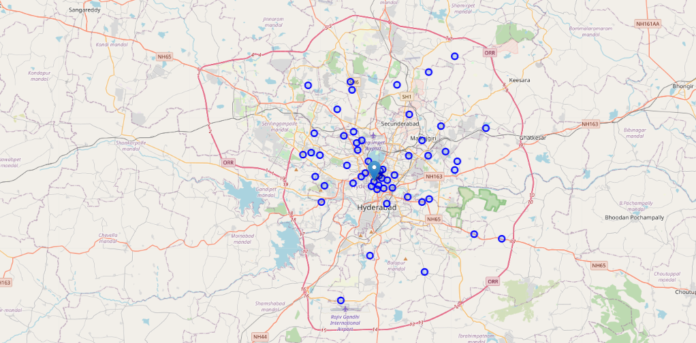
Methodology
Use Geopy to get Lat, Long co-ordinates of the Hyderabad city.
To get the list of localities in the Hyderabad and their co-ordinates & plot on the map

Slide 5
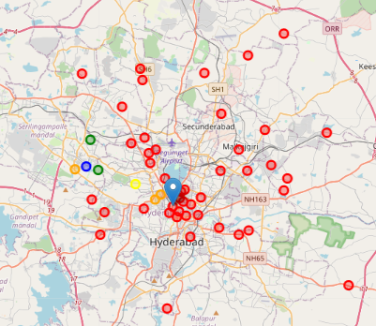
Methodology
Clusters in City to Identify Italian Restaurants
Cluster 1- RED
Cluster 2- GREEN
Cluster 3 - BLUE
Cluster 4- ORANGE
Cluster 5- YELLOW
K Means Clustering is used to identify the Clusters

Slide 6
Results & Observations
Cluster-1(shown with red color) has no existing Italian Restaurant
Cluster -3 has the highest number of Italian Restaurants (shown with blue color).
Moderate number of Italian Restaurants are present in cluster-2 & cluster-5(shown with green, yellow color)
Low number of Italian Restaurants are found in cluster-4 (shown in orange color).
The analysis shows that most of the Italian restaurants are spread across central to North west region of the city.
There are no restaurants in the eastern part of the city.
There are no Italian restaurants in the outer parts of the city.

Slide 7
CONCLUSION
Cluster-1 and cluster-4 are the best options for the outsider/ investors to open the Italian restaurant in Hyderabad.
As Cluster 1 has no Italian restaurants, more marketing expenditure restaurant need to spend, while for cluster-4 which already has existing Italian restaurants with very low competition can attract the existing customers visiting to other Italian restaurants along with new customers.

